Slide 1
Cloud

Slide 2
SSOW Cloud Syllabus
1. Containerization and Orchestration Tools
1.1 Docker
1.2 Kubernetes
1.3 Terraform
1.4. Ansible
1.5 Helm (optional) 2. Cloud Providers
2.1 AWS
2.2 GCP

Slide 3
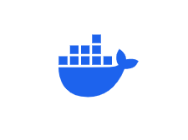
1.1 Docker

Slide 4
Prerequisites Terminologies
Virtual Machine and Hypervisor
Pre-Cloud Era – On Premise & its complexities , Cloud Basics

Slide 5
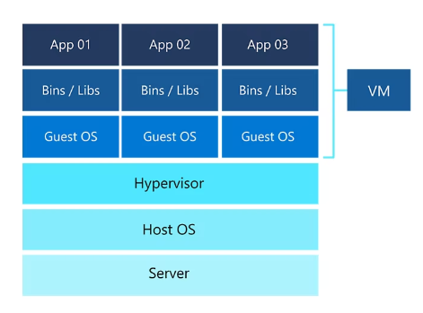
Virtualization
Virtualization is the process of creating a virtual version of something,such as a server, storage device, network resource, or operating system
– Virtualization enables multiple operating systems and applications to run concurrently on a single physical machine. – This technique allows each VM to act like a fully functional independent computer, each with its own OS and application stack.

Slide 6
Hypervisor:
Hypervisor is software that creates and manages virtual machines. It sits between the hardware and the VMs, allocating resources such as CPU and memory to each VM.
Types:
Type 1 (Bare-metal): Runs directly on hardware (e.g., VMware ESXi, Microsoft Hyper-V).
Type 2 (Hosted): Runs on a host OS (e.g., VirtualBox, VMware Workstation).

Slide 7
Cons of Virtual Machine:
Overhead: Each VM required a full operating system, which consumed a significant amount of resources (CPU, RAM, storage).
Slow Startup: VMs took longer to start because each needed to boot its own OS.
Resource Inefficiency: The hypervisor consumed additional resources, and not all VMs could efficiently share the physical machine’s resources.

Slide 8
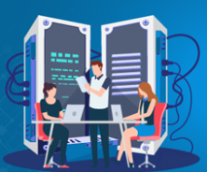
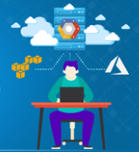
On Premise Model
Cloud Model

Slide 9
Problems in Pre-Docker Period:
Setting up VM
Duplicate Effort
Manual Setup
Scaling Challenges

Slide 10
Docker
It is a platform that uses OS-level virtualization to deliver software in packages called containers.
- Docker is an open platform for developing, shipping and running applications. - Docker uses Containers. - Docker enables you to separate your applications from your infrastructure.
Purpose: Docker is used to ensure consistency across development, testing, and production environments by allowing developers to package their applications with all dependencies.

Slide 11
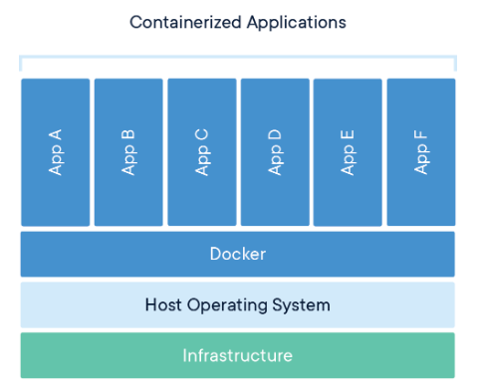

Slide 12
Docker Technique:
Docker introduced containerization, which isolates applications and their dependencies in lightweight containers.
Containers: are lightweight, portable units that include everything needed to run an application, including the code, runtime, libraries, binaries and system tools.
Unlike Virtual Machines, containers share the host OS kernel, which reduces overhead and allows for faster startup times and more efficient resource usage.

Slide 13
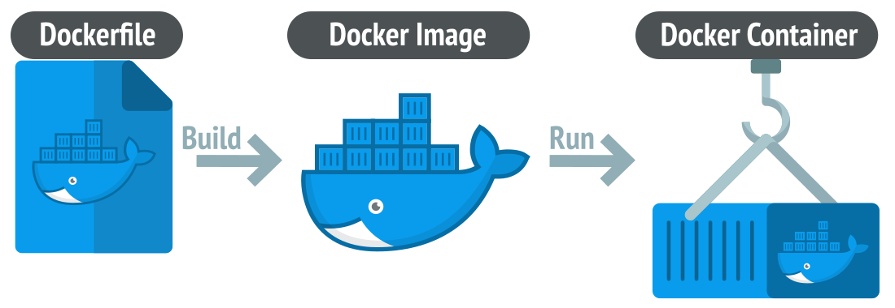
Core Components:
Docker Image
Docker Container
Dockerfile
Docker Compose

Slide 14
Core Docker Concepts:
Docker Image:
– An image is a read-only template with instructions for creating a Docker container.
– A lightweight, standalone, executable package that includes everything needed to run a piece of software, including the code, runtime, libraries, and system tools. Images are read-only templates.
Docker Container:
– Containers are lightweight and contain everything needed to run the application.
– Containers are runnable instance of an image. Containers can be created, started, stopped, and deleted, and they are isolated from each other and the host system.

Slide 15
Core Docker Concepts Cntd..
Dockerfile: A text file that contains instructions for building a Docker image. It specifies the base image and the steps needed to configure and build the application.
Docker Compose: A tool to define and run multi-container Docker applications. You use a docker-compose.yml file to configure the application’s services (e.g., frontend, backend, and database).

Slide 16
What problem does Docker solve, and how does it benefit software development and deployment? Consistency: Containers ensure that the application works the same way across development, staging, and production environments.
Efficiency: Containers are lightweight and use fewer resources compared to VMs.
Portability: Docker containers can run on any system that supports Docker, from local development machines to cloud environments.
Version control: Docker images provide versioning, enabling easy rollbacks and updates.
Rapid deployment: Containers start quickly, speeding up development and deployment processes.

Slide 17
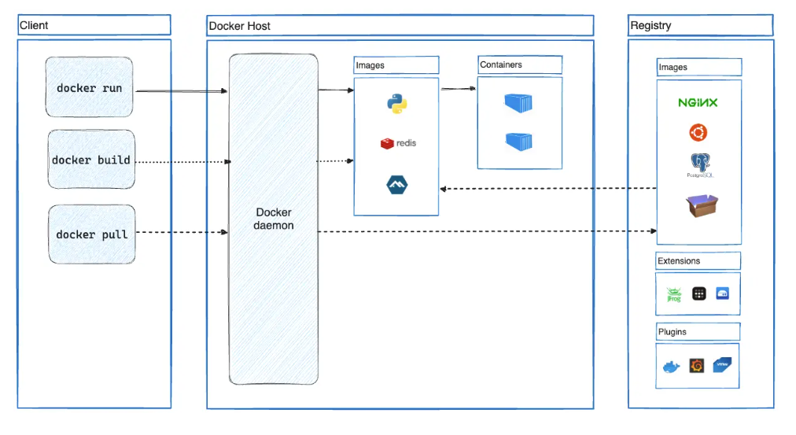
Docker Client-Server Architecture

Slide 18
Docker Client: The client is the command-line interface (CLI) used to interact with the Docker daemon. Commands such as docker run, docker build, and docker pull are executed from here.
Docker Daemon (Server): The daemon (or server) listens for commands from the Docker client. It builds, runs, and manages containers on the host system.
Registry (Docker Hub): The Docker registry stores Docker images. Public registries like Docker Hub allow users to pull and share images. Private registries can also be set up for internal use.

Slide 19
Comparison
Features | Virtual Machines | Docker (Containers)
Isolation | Full OS virtualization | Shares same host OS (App Isolation)
Startup Time | Takes time to boot | Fast
Resource Overhead | Requires Full OS (for each VM) | Shares same host OS
Portability | OS and Hypervisor (dependent) | Runs consistent across env
Deployment Speed | Slower | Smaller and faster

